Slide 1
C# 8.0 Programming with .NET Core 3.
Sarita Lad
DATE

Slide 2
Why .NET Core ?
NET Core is best used for cross-platform application development, for enabling developers to leverage CLI (command-line interface) control, and for deploying enterprise cloud applications

Slide 3
The original .NET framework had several drawbacks that made it a difficult first choice for developers and firms, namely, the need for proprietary licenses for Windows servers/systems, and the ability to develop only for Windows systems
The .NETCore managed development framework has all of the significant advantages of the .NET framework, while greatly expanding on its abilities to enable firms to increase their development productivity, while helping them to limit overhead/costs and decrease the timeline associated with their application and software development life cycles.

Slide 4
The most essential differences between the .NET Core system and the .NET framework include:
.NET Core is open source
.NET Core can be used on a variety of platforms (MacOS, Linux, Windows), while .NET Framework only supports Windows Applications
.NET Core uses a modified CLR, the Core CLR
.NET Core feasibly supports Cloud and IoT applications
.NET Core does not require expensive Windows/Server licenses and Windows system for use. The use of the .NET framework, on the other hand, could often result in hefty financial costs due to requiring proprietary Windows systems/licenses.

Slide 5
features to build better applications with ASP.NET Core
Cross-platform & container support. ...
High performance. ...
Asynchronous via async/await. ...
Unified MVC & Web API frameworks. ...
Multiple environments and development mode. ...
Dependency Injection. ...
WebSockets & SignalR. ...
Cross-Site Request Forgery (CSRF) Protection.

Slide 6
1. “dotnet new console”
The above command is used to create a new “dotnet core console application”. As the name of the application is not specified in the command so the project will be created by the name of the directory the command is executed in it. This command also performs an implicit restore of dependencies required for the project.
2. “dotnet new console --name hello
The command creates a “Hello”
directory only if doesn’t exist and then creates a “dotnet core console application” in it, the name of the project file is “Hello.csproj”. The command also performs an implicit restore of dependencies required for the project.
3. “dotnet new console –name “Hello” –no-restore”
The command creates a “Hello” directory only if it doesn’t exist and then creates the “dotnet core console application” in it, the name of the project file is “Hello.csproj”. The command does not perform any restore operation and create only two files viz: Hello.csproj and Program.cs. The content of the Hello directory is given below

Slide 7
dotnet commands on CLI: Command Line Interface
dotnet new –list…………………………. Templates list
dotnet new console -n "hello"
dotnet new mvc -n “mvcdemo“ –f netapp5.0
dotnet new web -n "hello" –force……………to overwrite prev project with same name
dotnet new webapi -n "helloservice"

Slide 8
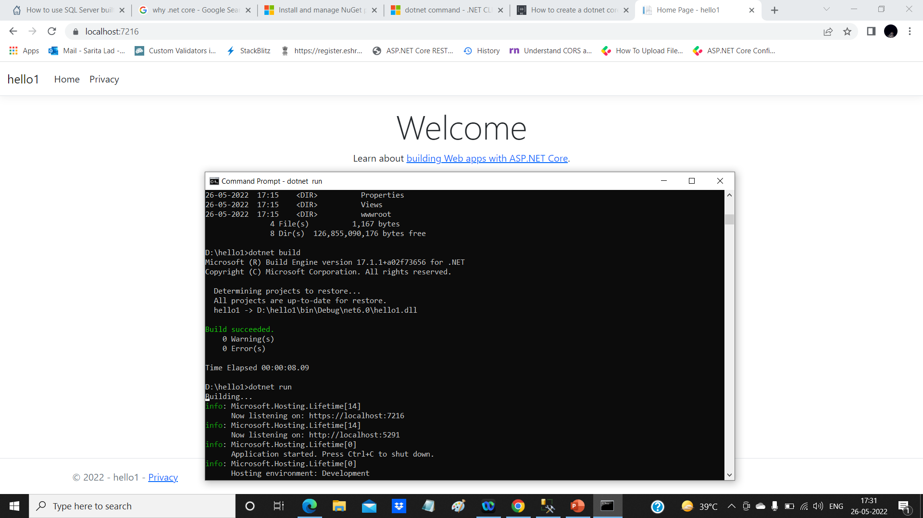

Slide 9
Data Types
Primitive Data Types: Value Type
Composite data Type:Ref Type
Int
Float
Single
double
bool
byte
struct
String
Array
Class
interface
Delegate
object

Slide 10
Type | Typical Bit Width | Typical Range
char | 1byte | -127 to 127 or 0 to 255
unsigned char | 1byte | 0 to 255
signed char | 1byte | -127 to 127
int | 4bytes | -2147483648 to 2147483647
unsigned int | 4bytes | 0 to 4294967295
signed int | 4bytes | -2147483648 to 2147483647
short int | 2bytes | -32768 to 32767
unsigned short int | Range | 0 to 65,535
signed short int | Range | -32768 to 32767
long int | 4bytes | -2,147,483,647 to 2,147,483,647
signed long int | 4bytes | same as long int
unsigned long int | 4bytes | 0 to 4,294,967,295
float | 4bytes | +/- 3.4e +/- 38 (~7 digits)
double | 8bytes | +/- 1.7e +/- 308 (~15 digits)
long double | 8bytes | +/- 1.7e +/- 308 (~15 digits)

Slide 11
C# Type Conversion Methods
Sr.No. | Methods & Description
1 | ToBoolean Converts a type to a Boolean value, where possible.
2 | ToByte Converts a type to a byte.
3 | ToChar Converts a type to a single Unicode character, where possible.
4 | ToDateTime Converts a type (integer or string type) to date-time structures.
5 | ToDecimal Converts a floating point or integer type to a decimal type.
6 | ToDouble Converts a type to a double type.
7 | ToInt16 Converts a type to a 16-bit integer.
8 | ToInt32 Converts a type to a 32-bit integer.
9 | ToInt64 Converts a type to a 64-bit integer.
10 | ToSbyte Converts a type to a signed byte type.
11 | ToSingle Converts a type to a small floating point number.
12 | ToString Converts a type to a string.

Slide 12
Dynamic Memory Allocation
Structure of data segment of .exe file in memory
Memory
Local variables
Heap section
Stack Area
Dynamically allocated variables(obj)
Data Section
Global variables static Variables
Code Segment

Slide 13
Input Output Statements keywords: var ,ref,out,params
var ,ref,out,params
Var keyword used for general data type ,when variable is declared without data type using var keyword,it must be initialized.
ref is used to access address in main function inside user defined method:
Ex: double Area (ref int r);
out is used to access address of variable( main) from user defined function
Ex: double Area(ref int r,out double a);

Slide 14
Difference between ref and out
ref | Out
The parameter or argument must be initialized first before it is passed to ref. | It is not compulsory to initialize a parameter or argument before it is passed to an out.
It is not required to assign or initialize the value of a parameter (which is passed by ref) before returning to the calling method. | A called method is required to assign or initialize a value of a parameter (which is passed to an out) before returning to the calling method.
Passing a parameter value by Ref is useful when the called method is also needed to modify the pass parameter. | Declaring a parameter to an out method is useful when multiple values need to be returned from a function or method.
It is not compulsory to initialize a parameter value before using it in a calling method. | A parameter value must be initialized within the calling method before its use.
When we use REF, data can be passed bi-directionally. | When we use OUT data is passed only in a unidirectional way (from the called method to the caller method).
Both ref and out are treated differently at run time and they are treated the same at compile time.
Properties are not variables, therefore it cannot be passed as an out or ref parameter.

Slide 15
Difference between ref and out
ref | Out
The parameter or argument must be initialized first before it is passed to ref. | It is not compulsory to initialize a parameter or argument before it is passed to an out.
It is not required to assign or initialize the value of a parameter (which is passed by ref) before returning to the calling method. | A called method is required to assign or initialize a value of a parameter (which is passed to an out) before returning to the calling method.
Passing a parameter value by Ref is useful when the called method is also needed to modify the pass parameter. | Declaring a parameter to an out method is useful when multiple values need to be returned from a function or method.
It is not compulsory to initialize a parameter value before using it in a calling method. | A parameter value must be initialized within the calling method before its use.
When we use REF, data can be passed bi-directionally. | When we use OUT data is passed only in a unidirectional way (from the called method to the caller method).
Both ref and out are treated differently at run time and they are treated the same at compile time.
Properties are not variables, therefore it cannot be passed as an out or ref parameter.

Slide 16
What is an object?
An object is an entity which has a well defined structure and behavior.
An object possesses certain characteristics as:
State
Behavior
Identity
Responsibility

Slide 17
State of Object
The state of an object includes the current values of all its attributes.
An attribute can be static or dynamic.
Employee Attribute
empId
Name
Gender
Age
Address
Phone
Basic _sal
Education
experience
Static
dynamic

Slide 18
Accesss Modifiers These are protection levels of data members and member methods
private->restricted to class only
protected->accessible to next child class
Internal->accessible in assembly
public->accessible in main() method

Slide 19
Practical Aspect
Class is in separate file and object is created inside main () function
Class contains two types of members
1 data members
2 function members
Both have 4 different levels of access
private: members are not accessible outside class
protected: memebers are accessible inside child class only
public:memebers are accessible outside class i.e. in main() function.
Usually members functions are public and data members are declared as private members

Slide 20
Constructor function
IT IS A VERY SPECIAL FUNCTION
It creates /constructs object in memory, it initializes object properties in memory.
Special things about Constructor
1 Name is same as that of class
2 It does not return any value not even void
Syntax:
Date()
{day =15;
month=8;
year =2017;
}
Two types of Constructors
1 Default constructor
2 Parameterised Constructor
int main()
{ // object of class date
Date d1 =new Date();
d1.setDate(20,6,2017);
d1.Display();
return 0;
}
default

Slide 21
Practical Aspect Example parameterised constructor
Class Date
{ int day,month,year;
public Date(int day,int month,int year)
{this.day=day;
this.month=month;
this.year=year;
}
}
int main()
{ // object of class date
Date d1=new Date(18,12,2017);
d1.Display();
return 0;
}
parameterised

Slide 22
object class and object methods
Object class is a standard class in .net Framework
It has four methods
ToString();
Equals();
GetType();
GetHashCode();
object of any new class developed by programmer is child of
this object class.
Therefore programmer has to override these 4 methods in new class according to need of that class.

Slide 23
Static data member,static method Containment
static data member is shared by all objects of the class, it is also called as class member
To access static data member , static method is required.
static member is called using class name .
Declaration:
Class MyMath
{
public static int number1
public static int number2
public void static Sum()
{
Console.Write(“Sum =“+ number1+number2);
}
}
public static main()
{
MyMath.number1=10;
MyMath.number2=20;
MyMath.Sum();
}

Slide 24
‘Has a’ Relationship Containment
Object of Date class is containded in class Employee as a data member
This relationship is called as ‘has a’ relationship.
i.e. employee has a date of joining
Example:
Class Employee
{
Int Id;
String Name;
Date Doj;
}

Slide 25
Class :abstract class,static class, abstract class,sealed class
class student
{
}
abstract class shape
{public abstract virtual void Area();
}
sealed class
{
}
static class mymath
{
}

Slide 26
Class :Inheritance “Is a “ Relationship
class base
{
}
class derived
{
}
Common things are abstracted into base class and special things are abstracted into derived class
Class Employee
{int id;
String name;
Decimal salary;
}
Class Manager:Employee
{ decimal commision;
Int sales;
}
Manager ‘is a’ Employee

Slide 27
Types of Inheritance in OOPs
Single Inheritance
Hierarchical Inheritance
class A
Class B
class A
Class B
Class C
Class D

Slide 28
Types of Inheritance in OOPs
Multilevel Inheritance
Hybrid Inheritance
class A
Class B
Class C
class A
Class B
Class D
Class E
Multiple inheritance is not present in c# language

Slide 29
Interface instead of multiple Inheriatance
Interface is a provider and it is implemented in a class which is a consumer class
There is a contract between interface and class :provider - consumer contract
Interface IPrintable
{void Show_Details();
}
Class Car:IPrintable
{
Void Show_Details()
{console.WriteLine(“ Model …”);
}
}

Slide 30
Automatic Properties (Short Hand)
# also provides a way to use short-hand / automatic properties, where you do not have to define the field for the property, and you only have to write get; and set; inside the property.
class Program {
static void Main(string[] args)
{ Person myObj = new Person();
myObj.Name = "Liam"; Console.WriteLine(myObj.Name);
}
}
class Person
{
public string Name
// property { get; set; }
}

Slide 31
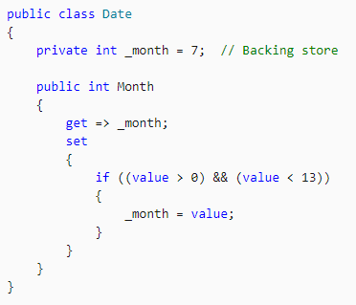
Properties have many uses: they can validate data before allowing a change; they can transparently expose data on a class where that data is actually retrieved from some other source, such as a database; they can take an action when data is changed, such as raising an event, or changing the value of other fields.
Properties are declared in the class block by specifying the access level of the field, followed by the type of the property, followed by the name of the property, and followed by a code block that declares a get-accessor and/or a set accessor. For example:

Slide 32
Thank You

